Slide 1
Company CV: Project Overview
Installation of five thousand cubic meter per hour water collection units in R.O in the year 2000.
Work execution period: One month.

Slide 2
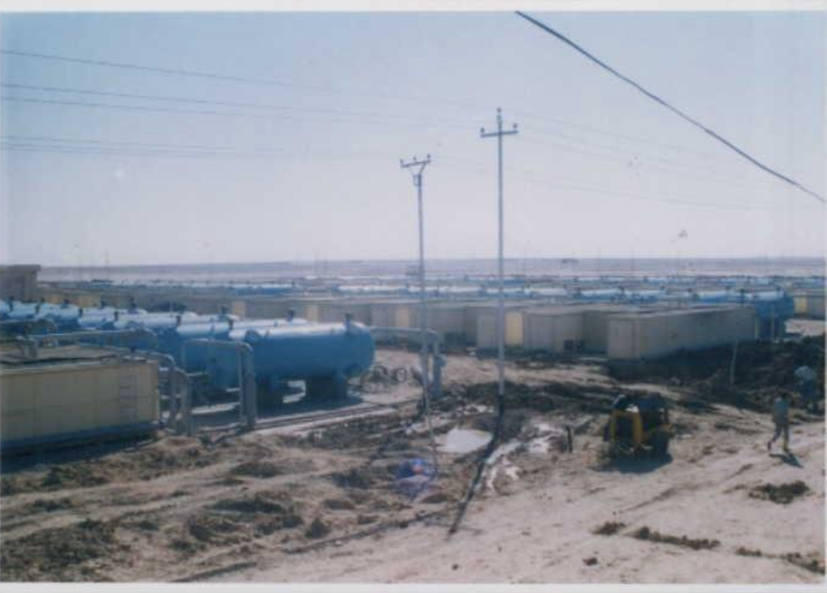

Slide 3
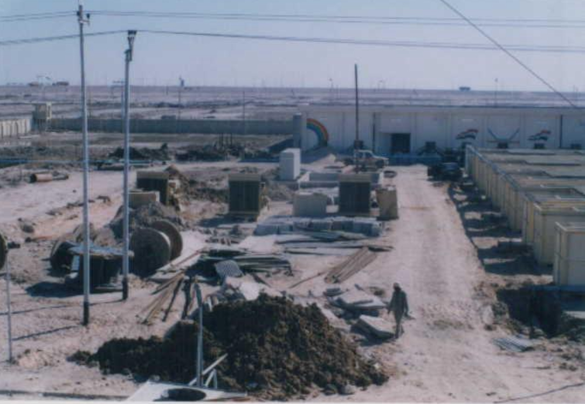

Slide 4
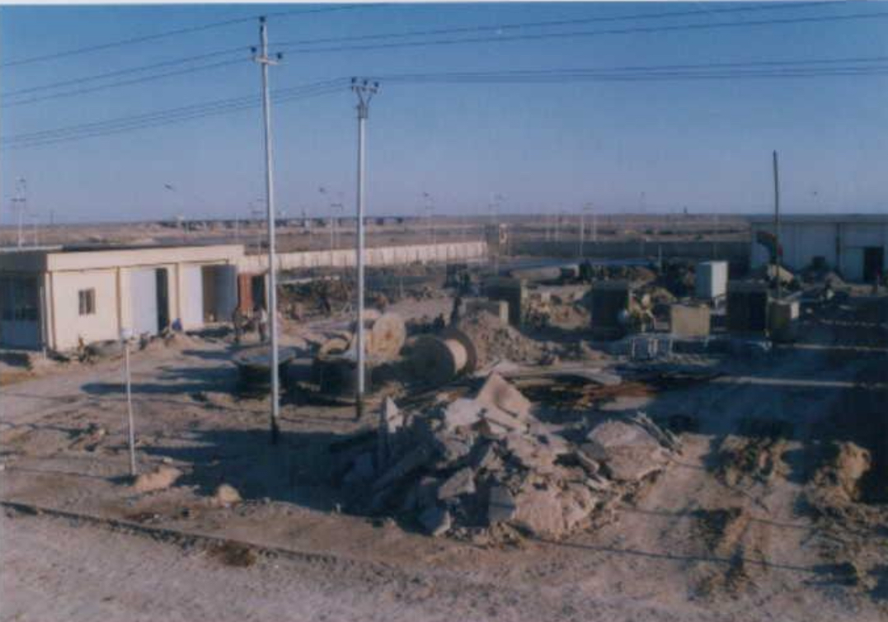

Slide 5
